Slide 1

Neural Optical Beam Propagation
Chengkun Li
Supervisor: Dr. Kaan Aksit

Slide 2
Motivation & Goals

Slide 3
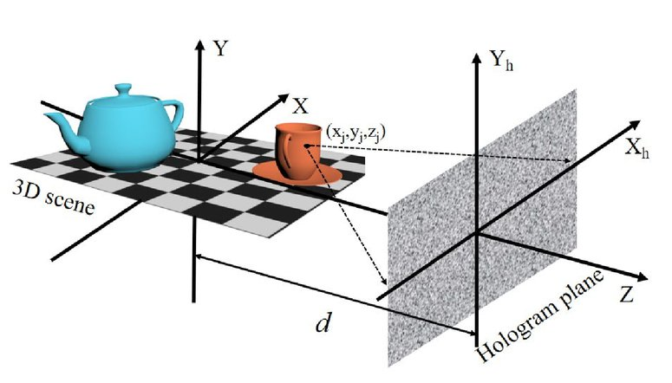
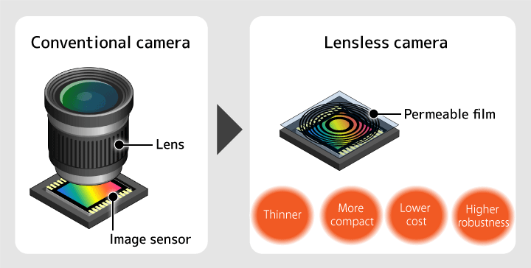
Motivation
Lensless camera
computer-generated holography (CGH)

Slide 4
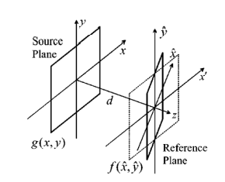
Goals
Simulate the beam propagation on the tilted plane by a DL method.

Slide 5
Methodology

Slide 6
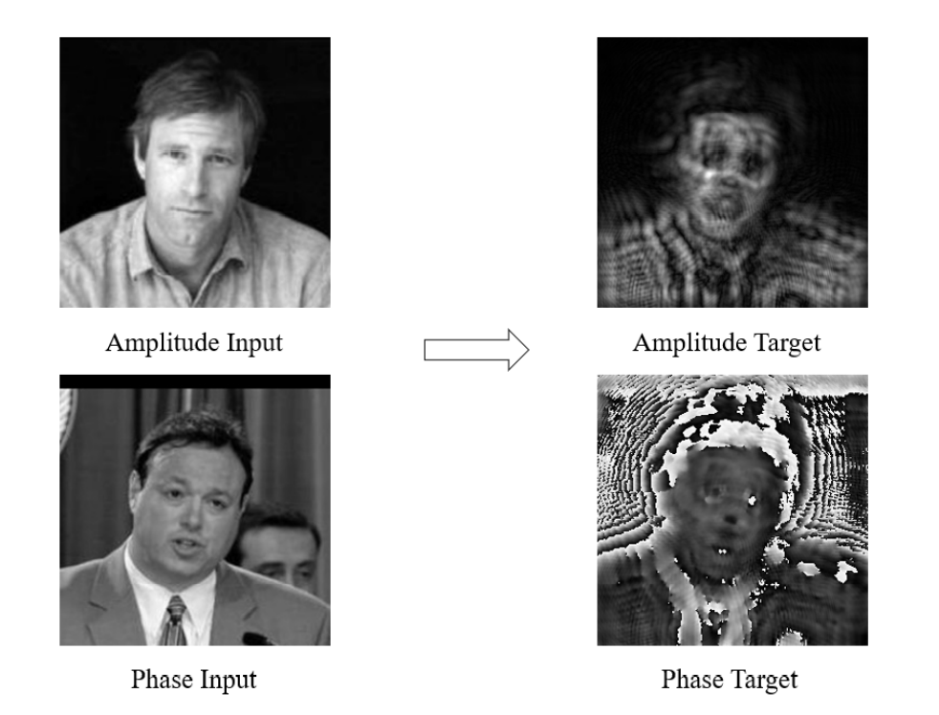
Synthesized Dataset
Generate the database by the traditional mathematic method (the fast rotation angular spectrum algorithm)
Actually, it is not the final result of the beam diffraction. And we eliminate the carrier frequency here. Because the non carrier frequency results look more meaningful for easily training our model. And this factor could be compensate later.

Slide 7
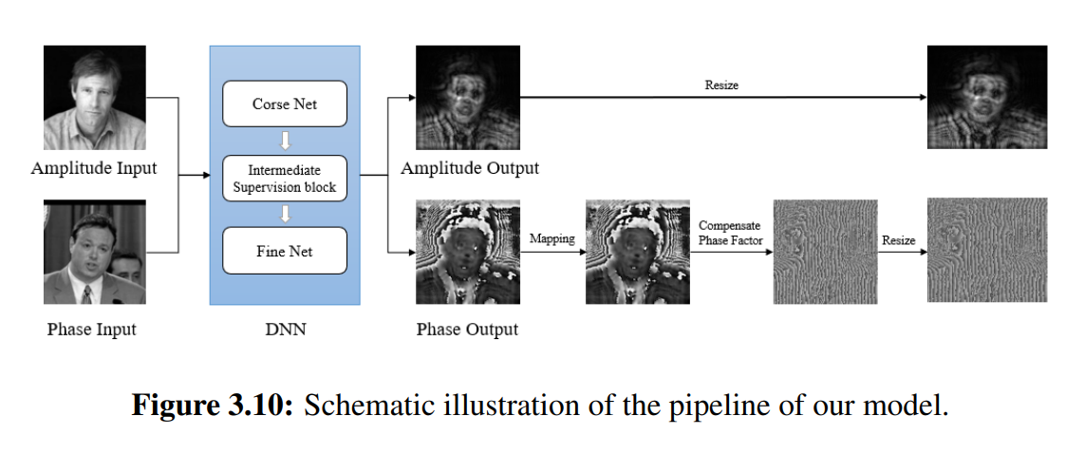
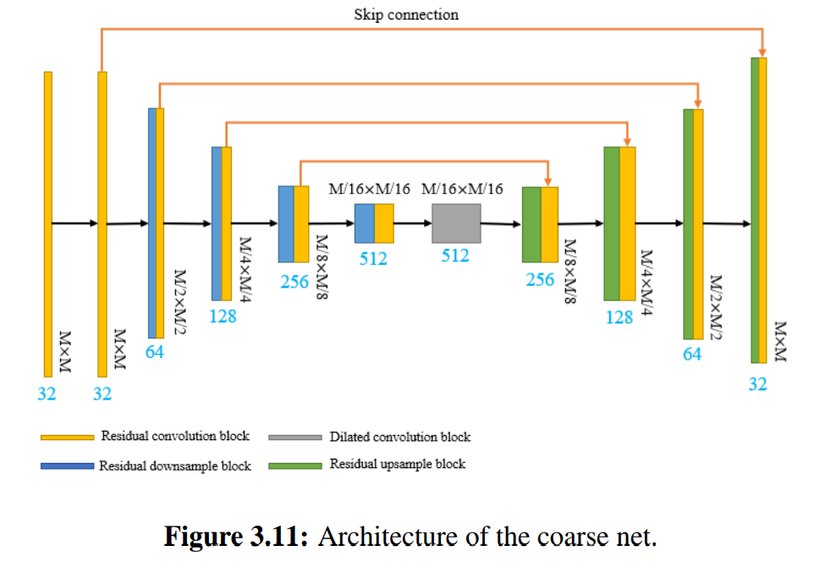
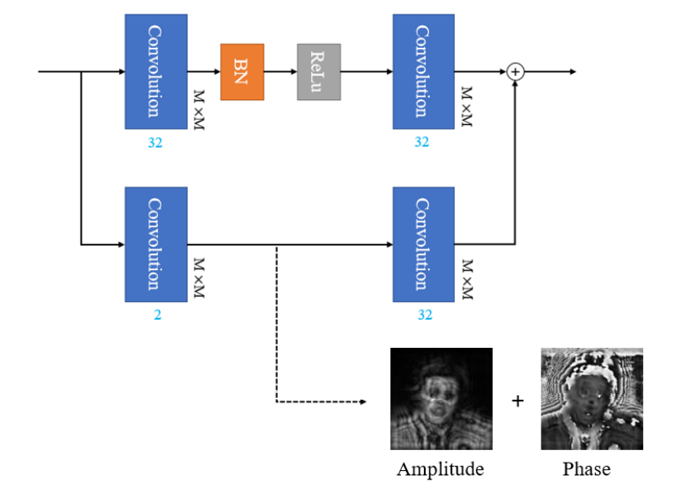
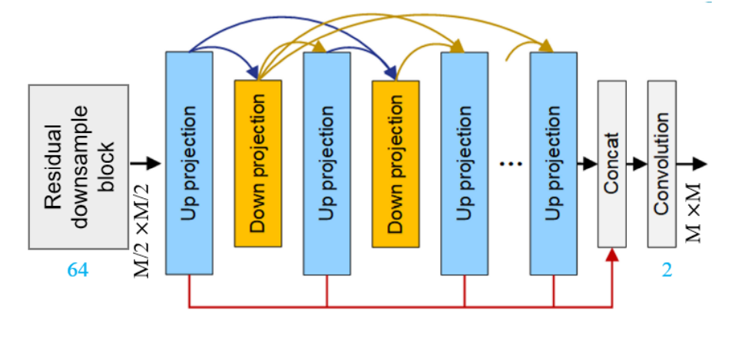
Neural Network
Schematic illustration of the pipeline of our model.
The Coarse Net
The Intermediate Supervision
The Fine Net

Slide 8
Experiments And Evaluation

Slide 9
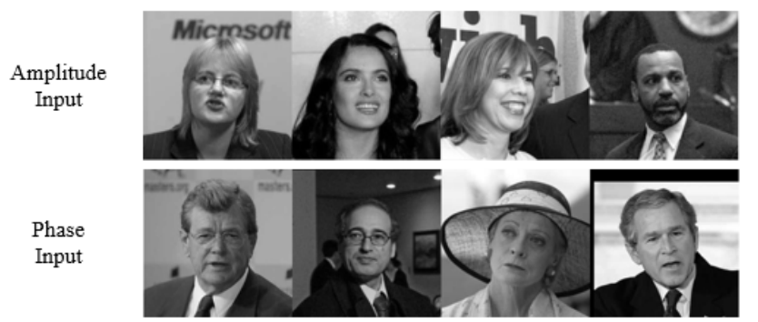
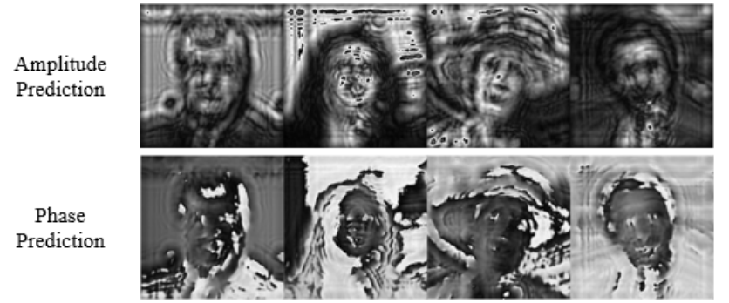
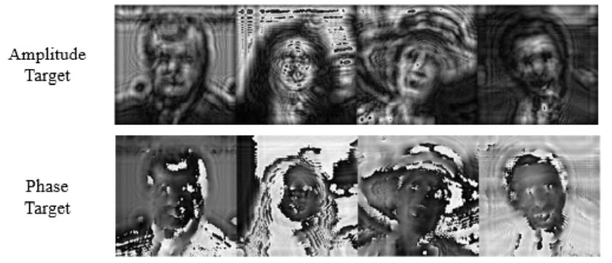
Qualitative Results
The experiment’s results for the 10° tilted plane and 10mm propagation distance.

Slide 10
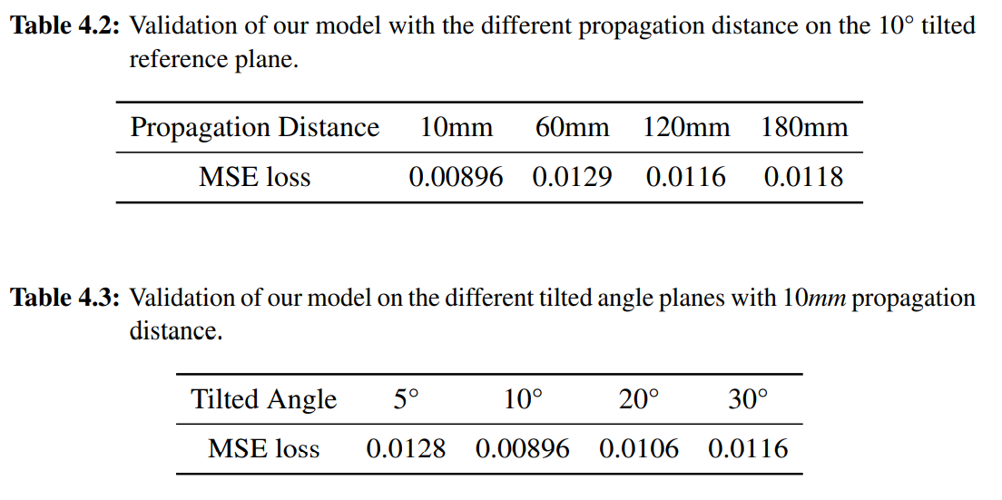
Quantitative Evaluation

Slide 11
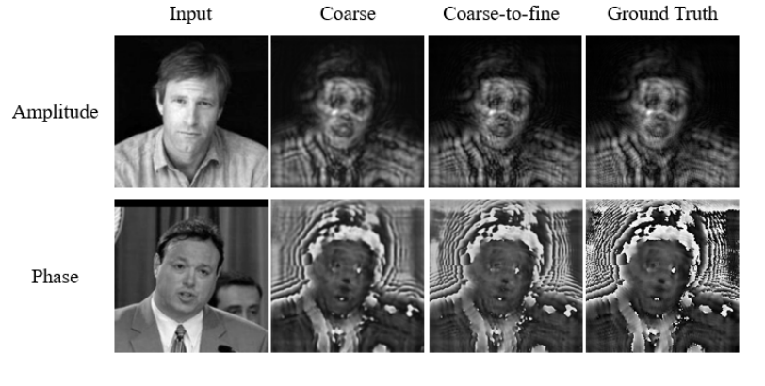
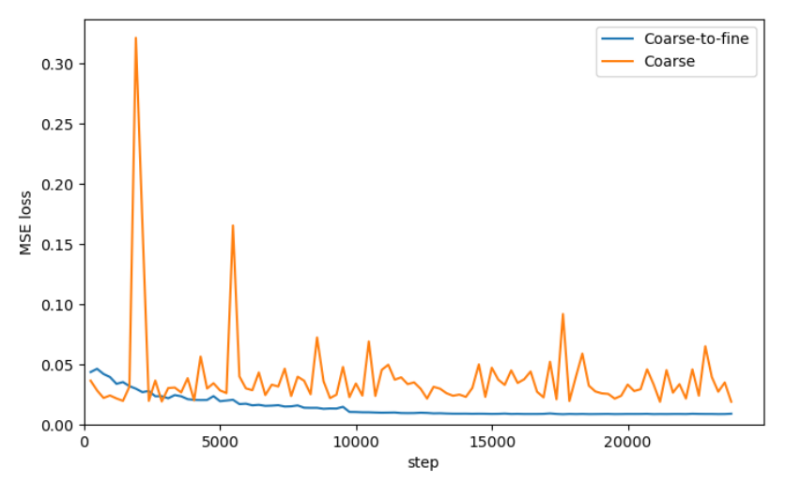
Ablation Studies
Qualitative results of the only-coarse net and coarse-to-fine net.
The evolution of the MSE with an increasing number of epochs.

Slide 12
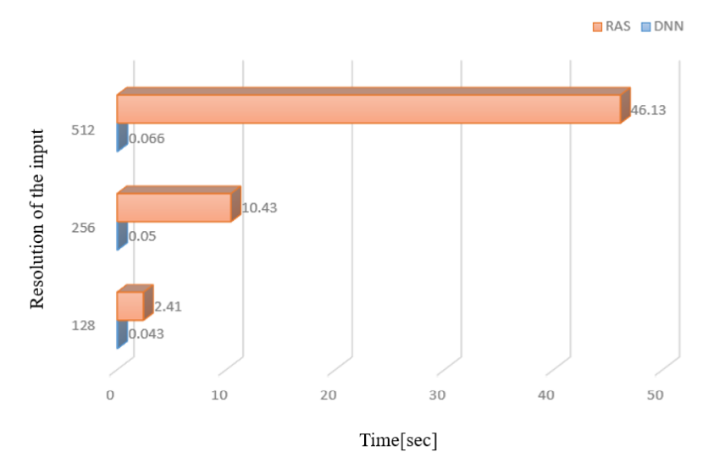
Running Speed
Running time of the fast RAS method and our DNN model with different resolutions of amplitude and phase image as input.

Slide 13
Extension

Slide 14
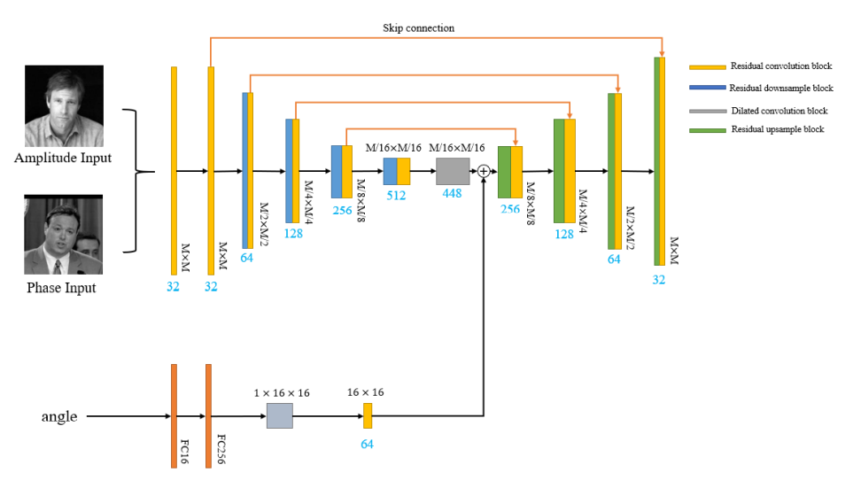
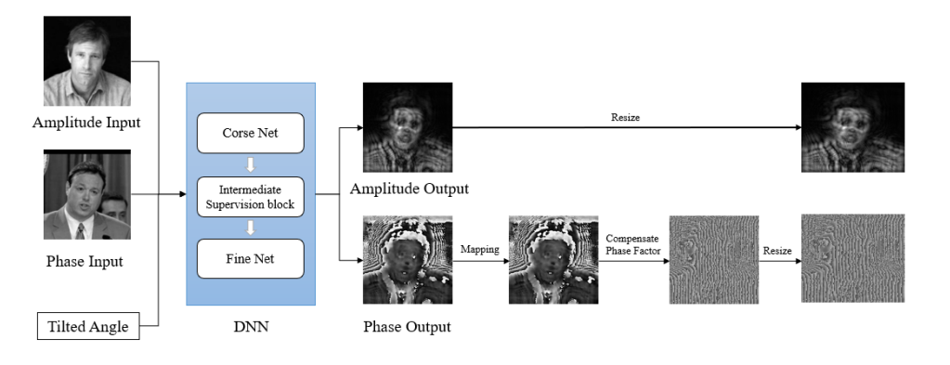
The Model
Schematic illustration of the pipeline for the model with an additional scalar input.
Architecture of the coarse net for the model which has an additional angle input.

Slide 15
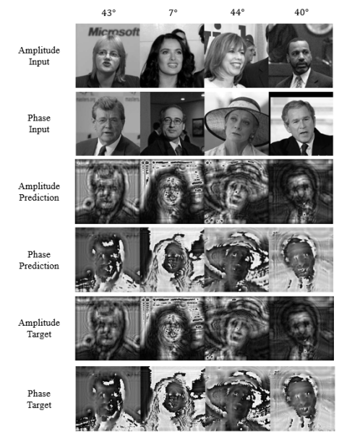
Qualitative Results
The results of the model which has an additional angle input.

Slide 16
Conclusions

Slide 17
Conclusions
By several experiments, we firstly demonstrate that the deep learning method has a great capacity to simulate the beam propagation.
We propose a frame to calculate the beam diffraction pattern on the tilted plane. And we suggest a coarse-to-fine neural network. Our network shows a great performance for simulating beam propagation .
We do some explorations to extend our network, and make it suitable for an exterior input, like the tilted angle of the hologram plane.

Slide 18
Thanks!!!

